Slide 1
Kick-off Session
Thank you for downloading this deck. To help you make the most of it, please keep the following in mind:
When to use: After you’ve selected the roles and know who the recruiters and hiring managers are
Intended Audience: recruiters, hiring managers, interview panelists, and anyone else involved in the recruitment process
Goal of training: Prepare the entire hiring team for recruitment, including overcome bias and best interview returners
Customize the content and branding of these slides for your program

Slide 2
Hiding in Plain Sight:
Finding the Talent We Need in an Unexpected Place

Slide 3
Today’s Objectives:
Returnship Program Details
Recruiting and Interviews
Marketing of the Program
Overcoming Bias
Success Stories
Timeline and Next Steps

Slide 4
The Win-Win
Returners have:
Experience
Transferable and newly acquired skills
Soft skills in abundance
Diverse backgrounds
Strong motivation
Employers want:
Experienced talent, especially female talent
Diversity (gender, age, perspective, etc.)
More inclusive cultures

Slide 5
Returnships Deliver Results
80%
of program participants were offered ongoing employment
90%
two-year retention rate for program participants
Effective across all functions, including technical and other specialized roles

Slide 6
Program Details

Slide 7
Program Overview
16-week paid internships for midcareer professionals
Minimum 5 years work experience and 2 years out for caregiving
Any candidate who meets criteria can be hired, regardless of how the candidate heard about your program
Provides an on-ramp back to the workforce for participants
Gives you a low-risk way to try out talent
Managers receive training, support, and best practices
Returners receive feedback sessions, networking with returners within the company, and ongoing support
Notes:
This should be tailored to your company’s program

Slide 8
Program Overview
Kick Off
Review program materials
Answer questions
Get started
Recruiting
Find great candidates!
Onboarding
Give them a great welcome
Set clear expectations
Assessment
Give feedback and develop
Make decisions
Offboarding
Transition support

Slide 9
Returner Support
Access to written modules on a variety of topics, including:
Renegotiating work/life balance
Success plans and agency
Integrating feedback
Networking and career management
Access to the Path Forward online community of returners
Company programming, including….
Notes:
This should be tailored to your company’s program

Slide 10
Recruiting & Interviewing

Slide 11
Recruitment Logistics
Roles will be/are posted in your ATS, candidates will apply directly to your company, and candidates will be screened by recruiters
We will promote internally, on social media, and your recruitment team may opt to source eligible candidates using your standard process
All hiring decisions – for returnship and at the end of the program - are made by managers

Slide 12
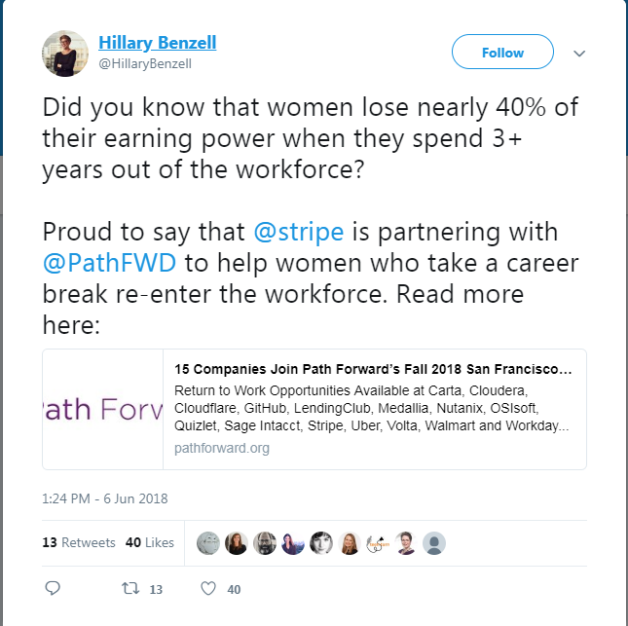
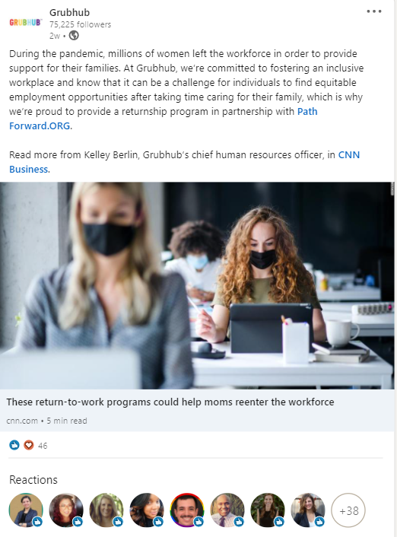
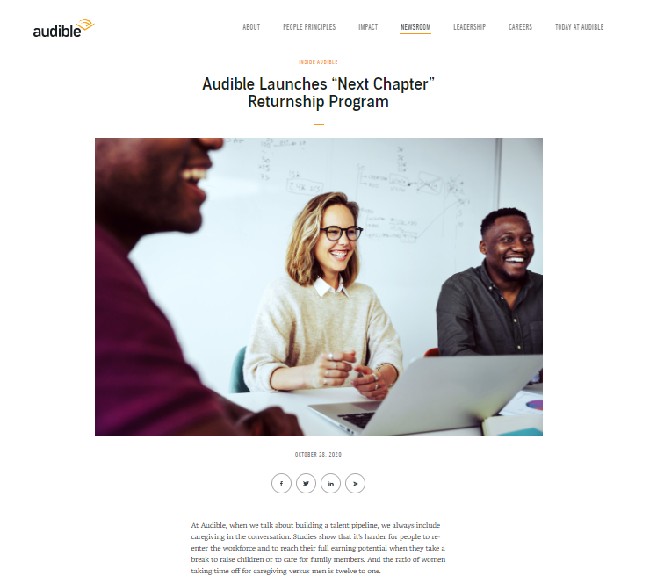
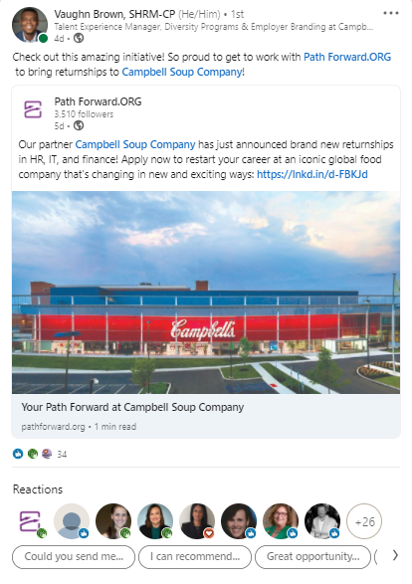
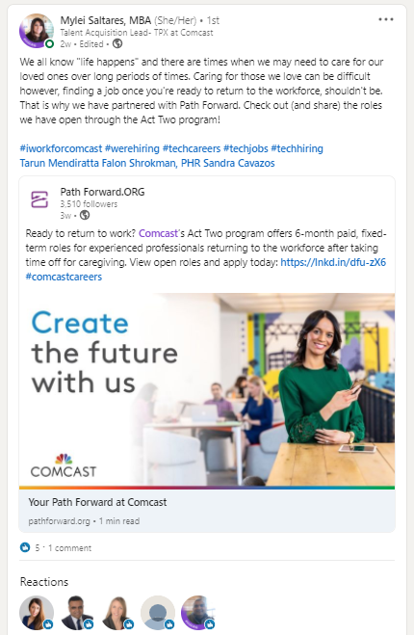
How You Can Help Spread the Word
Company Blogs
Company Social Media
Employee Evangelism

Slide 13
Tailoring your
Recruitment
Process

Slide 14
General Interviewing Advice
Form an interview panel that reflects the diversity you’re looking to see.
Evaluate the candidates holistically when determining fit. Ask yourself:
Do I think, with the right amount of coaching, support and ramp-up time, this person could be poised for longer-term success here?
What do I need to know in the initial interview phase to feel confident extending an offer and what are the skills I can see develop over the course of the 16-week program?
Previous career assets
Reskilling, formal or informal
Volunteer work and other life experiences
Place value on technical and soft skills
Consider screening in vs. screening out

Slide 15
Modified Screening Process for the Program
Initial resume screening
Does this person meet the criteria of the program and have relevant experience and/or education?
Initial information interview
Does the candidate match the resume?
Discuss the opportunity in more detail and provide overview of the recruitment process
Allow plenty of time for questions. Do the questions indicate that the candidate is informed about and interested in the company?
Technical screening
Candidates are given a choice between a take-home online assessment or a live coding exercise
Not focused on specific code syntax, but rather on candidate’s thought process, problem solving skills, and whether the solution makes sense
Team interview
Reduced from typical two sessions to just one with ~4 panelists attending. Panel should reflect the diversity of the team.
Looking to learn more about the candidate while further assessing soft skills and technical skills
Allows candidate to meet more members of the team and ask questions
Reference check
Reduced from 2 to 1
References may come from previous employer, professor, volunteer organization, teammate, etc.
Notes:
This should be modified to your program.

Slide 16
Do’s and Don’ts during Recruitment
Do:
Use the program criteria as a guideline, not a hard rule
Take time to thoroughly explain the recruitment process and what to expect at each stage fo the process
Prioritize interviews and internal communication
Trust the process
Don’t:
Worry about “proving” someone’s career gap
Disqualify applicants who may have done gig, freelance or pro bono work during their break
Leave applicants hanging
Mistake nerves or lack of confidence for a lack of competence

Slide 17
What Can I Expect From Candidates?

Slide 18
Plain page
Candidates May Not Seem Confident or Polished

Slide 19
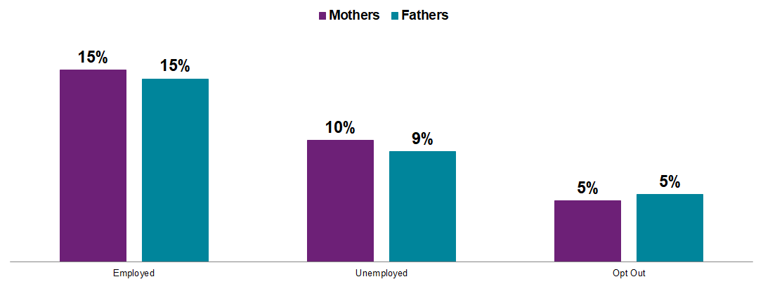
Parents specifically face a tough road to re-entry
Callback rates on the same resume vary significantly based on employment status:
Those Who “Opt Out” for Caregiving Face a Higher Hurdle
Source: From Opt Out to Blocked Out: The Challenges for Labor Market Re-entry after Family-Related Employment Lapses, Katherine Weisshaar, 2018

Slide 20
Creating a Comfortable Environment
Take time to introduce yourself and show excitement for the program
Let candidates know their gap is not a barrier
Be clear that candidates can share examples
Take breaks during long interview loops
Ask follow-up questions if candidates don’t give you enough detail
This could mean flipping a question into a hypothetical: “how would you approach X” vs. “tell me about a time when you…”

Slide 21
What Returners Bring to the Table
100% are looking to return to work after a break
11 years of prior professional experience (on average)
6 years out of the workforce (on average)
93% have a Bachelor’s degree or higher
47% have a Master’s degree or higher

Slide 22
Thinking About
Core Skills and Experiences

Slide 23
“There was a hunger to really prove themselves and be risk takers… I candidly would not have considered them if I had opened it up to a traditional hiring model simply because of their non-traditional experience. It’s made me reflect not on the job titles or even the very specific skills someone has to have on their resume, and really take a step back and say, ‘What are the problem-solving capabilities that come with what they’ve done and can that apply to what I’m looking for?’ It’s been such a great experience and there’s something about this program that really feeds into an entrepreneurial spirit.”
Stacey S.
Hiring Manager at Trimble

Slide 24
How Nonpaid Work Translates into Business
Running a volunteer project (PTA, religious org, community org) | Ability to persuade using influence vs. authority Ability to collaborate with different personalities, manage competing agendas Focus on goals and accomplishments Raise funds and maintain financial viability Ability and willingness to lead
Participating in a volunteer project | Maintain commitment to a cause despite ambiguity of roles and responsibilities Ability to collaborate with different personalities, manage competing agendas Manage your own performance to accomplish team’s goals Demonstrate passion and drive
Managing your child’s special needs case | Navigating complex bureaucracies and rules Adhering to deadlines and schedules Processing complex information and making decisions with limited information
Coordinating an international move | Navigating complex bureaucracies and rules Adhering to deadlines and schedules Adapting to differing culture and supporting family in their adaptation Learning a foreign language

Slide 25
Confronting
Bias

Slide 26
Combating Bias
Acknowledge that it exists; awareness is key to avoidance
Select diverse individuals for panel interviews
Avoid questions that may focus on a person’s age
Asking about what year they graduated
Asking how old their children are (if applicable)
Avoid assumptions when assessing a candidate
This person won’t feel comfortable reporting to a younger manager
This person will require too high of a salary
This person won’t be able to catch up
This person isn’t really motivated to get back into the workforce

Slide 27
Flipping the Script on Bias Ideas
This candidate is overqualified
This candidate has a variety of skills and experience to bring to the team
This candidate won’t find the role challenging enough
This candidate is using the returnship to ramp up and reskill
We’re looking for someone to hit the ground running
We’re looking for someone who is adaptable and willing to learn and grow
This candidate may not fit in on our team
This candidate has viewpoints and life experiences that will enhance our team

Slide 28
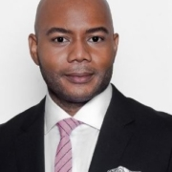
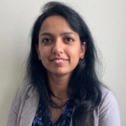
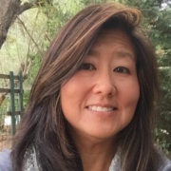
Success Stories Across Many Functions
Rachna
Product Engineer
Allstate
Richard
Project Manager Motorola
Alicia
Sales Enablement Manager
Sage
Payal
Business Initiatives Consultant
Wells Fargo
Cathy
Director of Tax
Volta
Denise
Technical Program Manager VMware
Pratyusha
Data Engineer Grubhub
Isabela
Production Supervisor
PepsiCo
Read more success stories here.

Slide 29
Tentative Program Timeline
What's happening? | When?
Program announcement
Jobs posted / recruitment window
Path Forward webinar
Hiring decisions made
Onboarding and launch events
Returnships in flight, participant workshops with Path Forward
Returnship end date and off-boarding

Slide 30
Q&A
“You can always build on an employee’s knowledge, but life experience can’t be taught. For instance, one of my returners had been an engineer, then took an eight-year career break. She took the time to raise her kids and do some teaching. So in addition to having the baseline technical knowledge to do well in her role, her career break gave her the maturity, emotional intelligence, and conflict-resolution skills that other candidates often lack.” – Trey, Manager at Cloudflare
Notes:
Common questions asked during kick off sessions:
Who will be doing the initial screening of candidates?
How will that person communicate with the manager about interviews?
How can I modify my specific recruitment process to be better suited to returners?
Are there any templates or guidance to help me promote our returnship on my LinkedIn?

